Slide 1
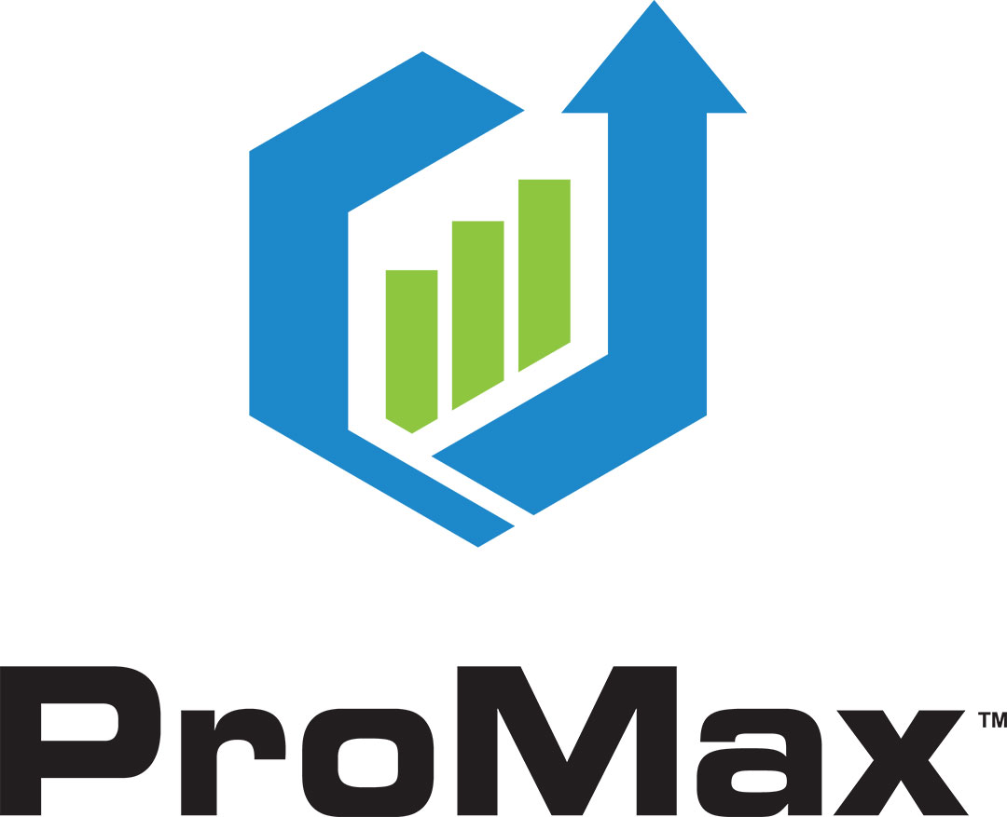
Leading the Automotive
Industry since 1994

Slide 2

NADA 2021
Welcome to the future of ProMax

Slide 3
Website Search-by-Payment
First Search-by-Payment
Dealer Websites
25 years
95
98
OF INNOVATION &
Industry Firsts
First Desking Solution
First Special Finance Desking Solution

Slide 4
Adapting to an ever-changing market and customer needs
02
05
07
Compliance Solution
First Compliance Integrated CRM/ILM
Internet Platform
First internet-based full front-end solution
Market Thief
First Automotive Trigger program

Slide 5
Continuously improving to help dealers succeed
Industry Recognition
Recognized as NADA Top Ten Company
09
14
16
First Pre-screen Tool
Instant Screen First Pre-screen Tool
Credit Solutions
3 Powerlead Products
The Work Number

Slide 6
Performance and stability is built into our technology and people
Serving thousand of dealers nationwide, no other customer support team is more dedicated.
Dependable
Certified
Preferred
Tenured
99.95% Up Time over the last 4 years
Certified by all major OEMs
One of only three resellers of all 3 Credit Bureaus
Industry-leading Executive Tenure & Employee Tenure

Slide 7
Powerful technology with a personal touch
Our greatest asset is our relationship with you
Tech Support
Your tech support team is standing by to answer your technical questions with care and precision. You call, they answer, and issues are resolved.
Sales
Your sales rep will go above and beyond to meet your needs. They don’t treat you like a sale –
they treat you like a friend.
That’s the ProMax difference
Customer
Support
Dealer
Satisfaction
Training
Think of your trainer as your own personal guru. Get the absolute most out of your ProMax system by learning from the best in the business
Dealer Support
Your dedicated support specialist is assigned directly to you and wants you to succeed as much as you do. You have direct, one-on-one access when you need it.

Slide 8
NEW
2021
Products & Features

Slide 9
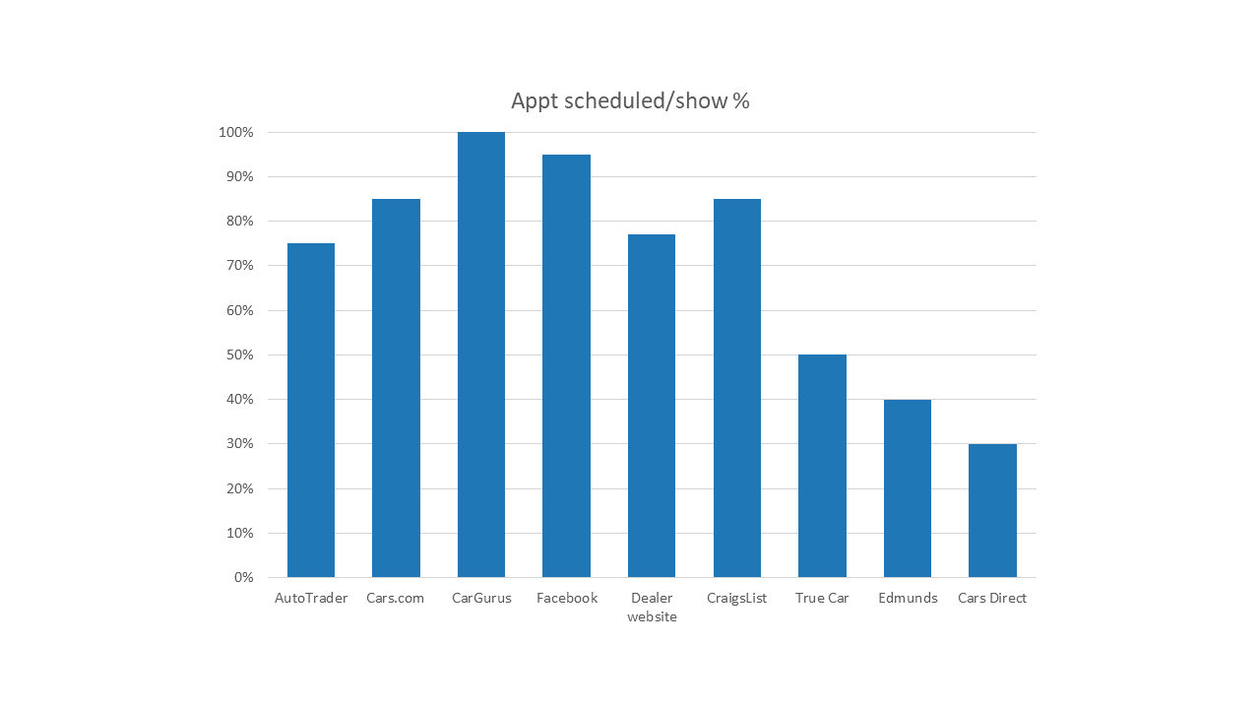
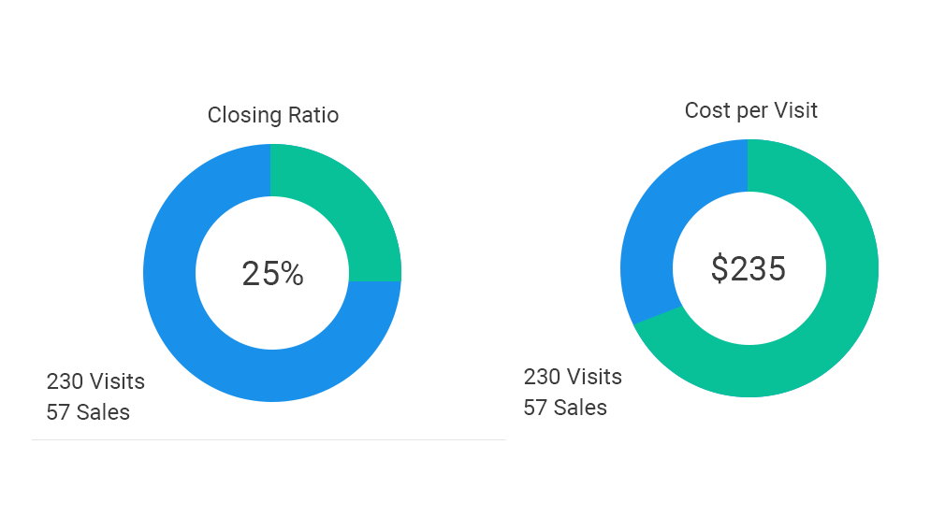
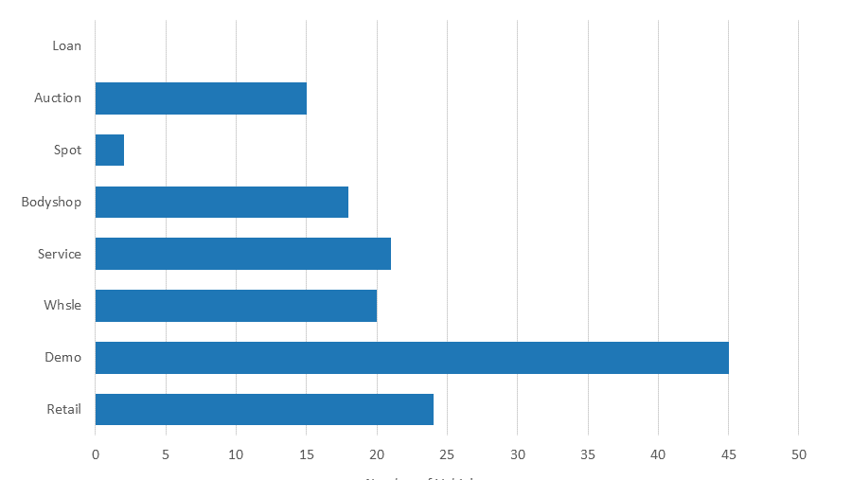
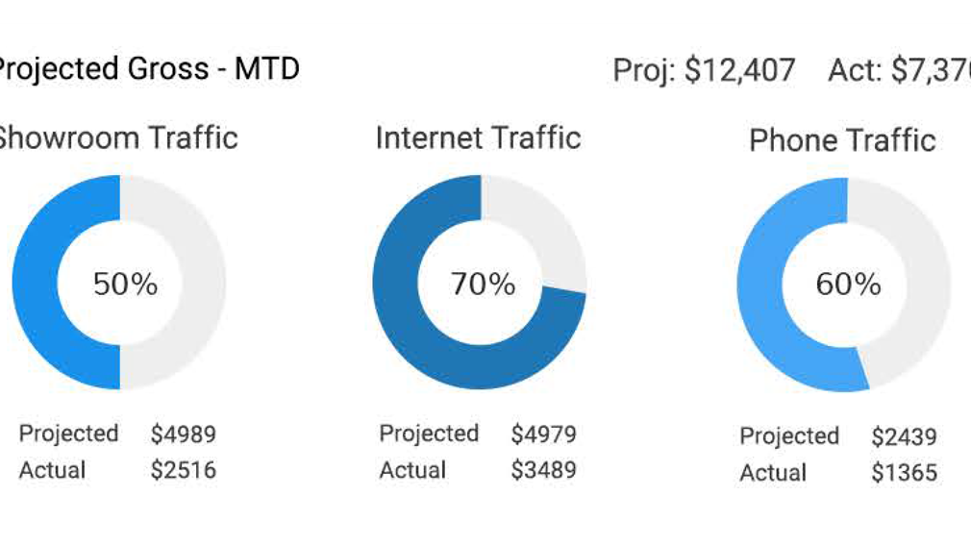
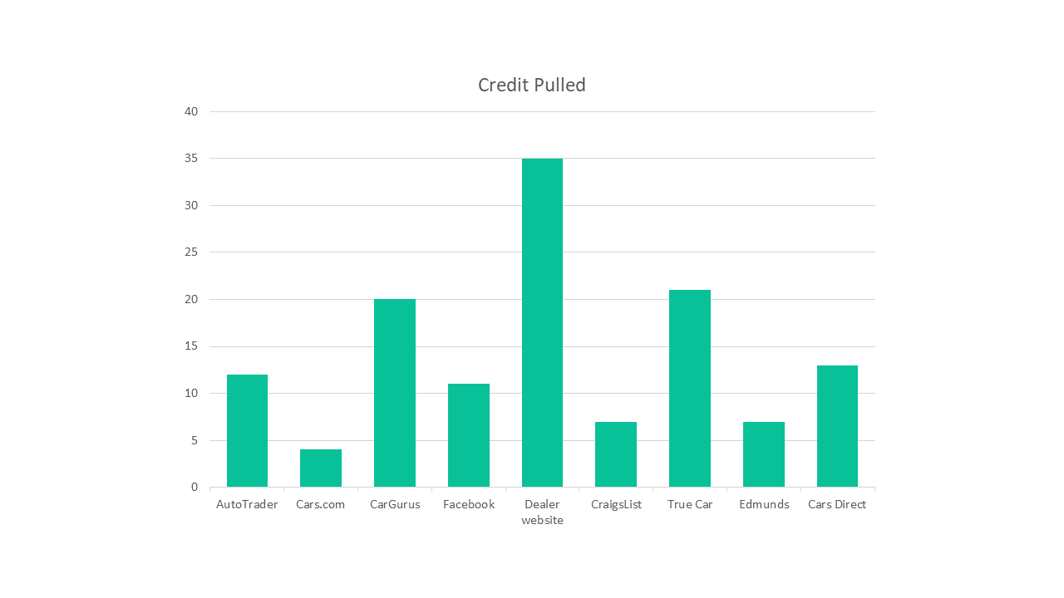
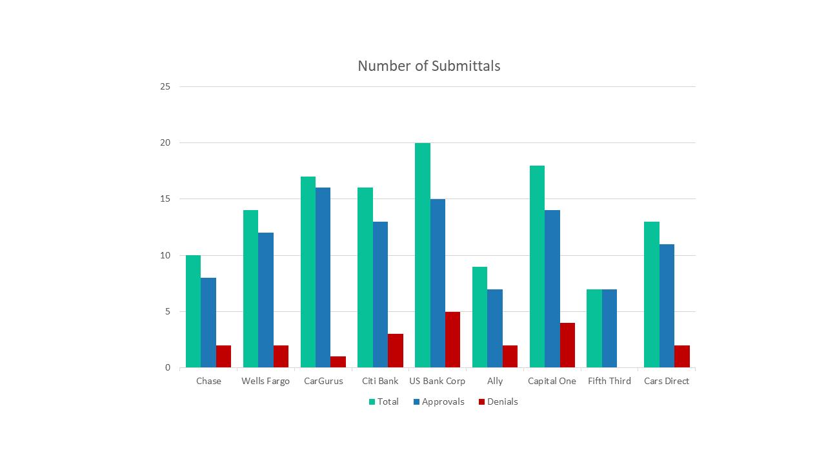
Analytics and Reporting
Store Traffic
Report
Our new Store Traffic Report is at the top of the list of new features that will benefit your dealership. This report lets you see how your store is performing over time and compares it to previous performance. Reporting data is broken down into total customers, internet submissions, showroom visits and phone traffic.

Slide 10
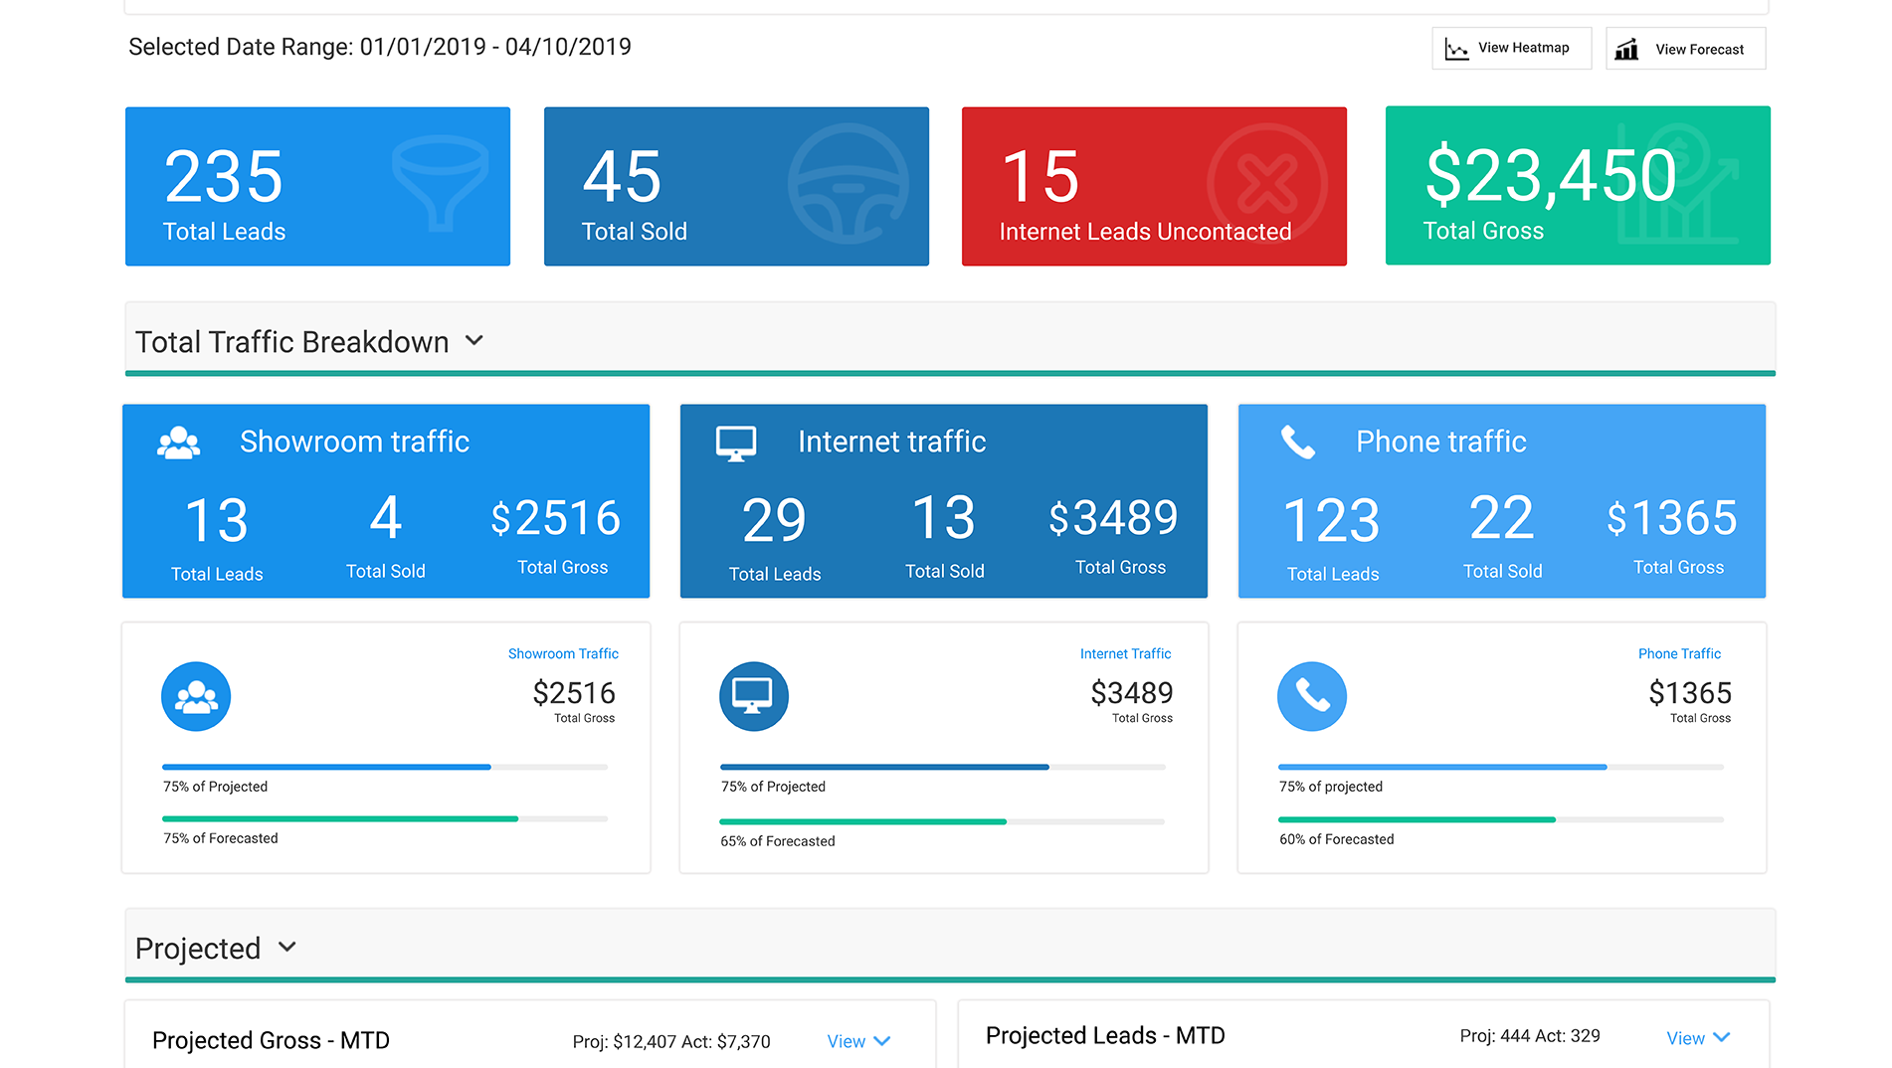

Understand your data and make better decisions.
The Store Traffic Report gives managers the ability to measure progress and manage expectations. View, sort, and evaluate every opportunity at the dealership: internet leads, phone calls, and showroom traffic. Sort and filter the information you need and get closing ratios and other KPIs.

Slide 11


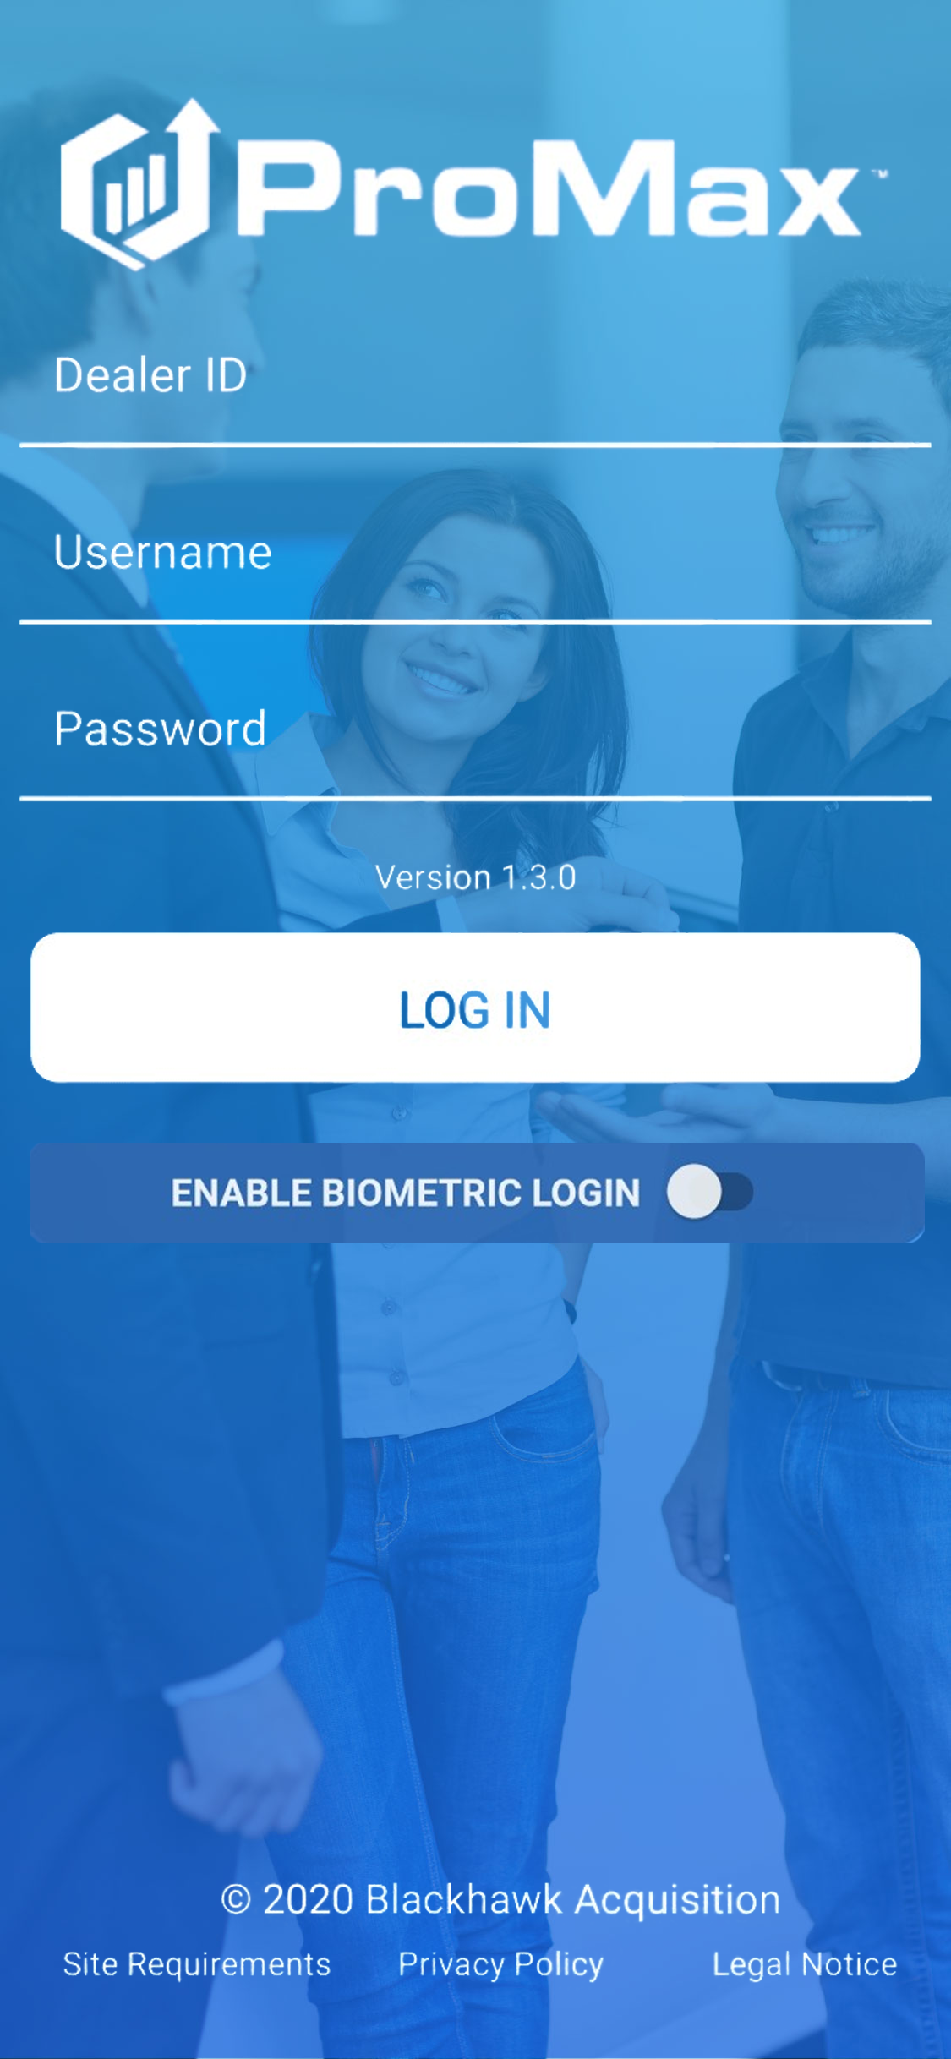
d
CRM at your fingertips
Access all CRM sales functionality to easily scan and log prospects, search Inventory, and provide follow up.
The All New ProMax App
Everything you need in ProMax on your phone!
b
Task Management
Manage key daily activities on your phone. Quickly respond to alerts, calls, email, and texts with this user-friendly app.

Slide 12
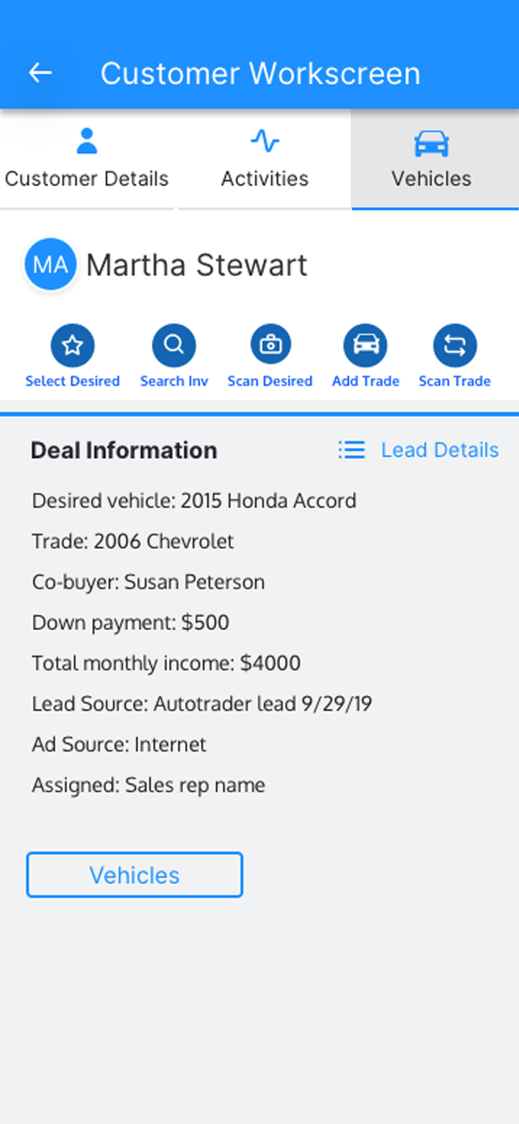
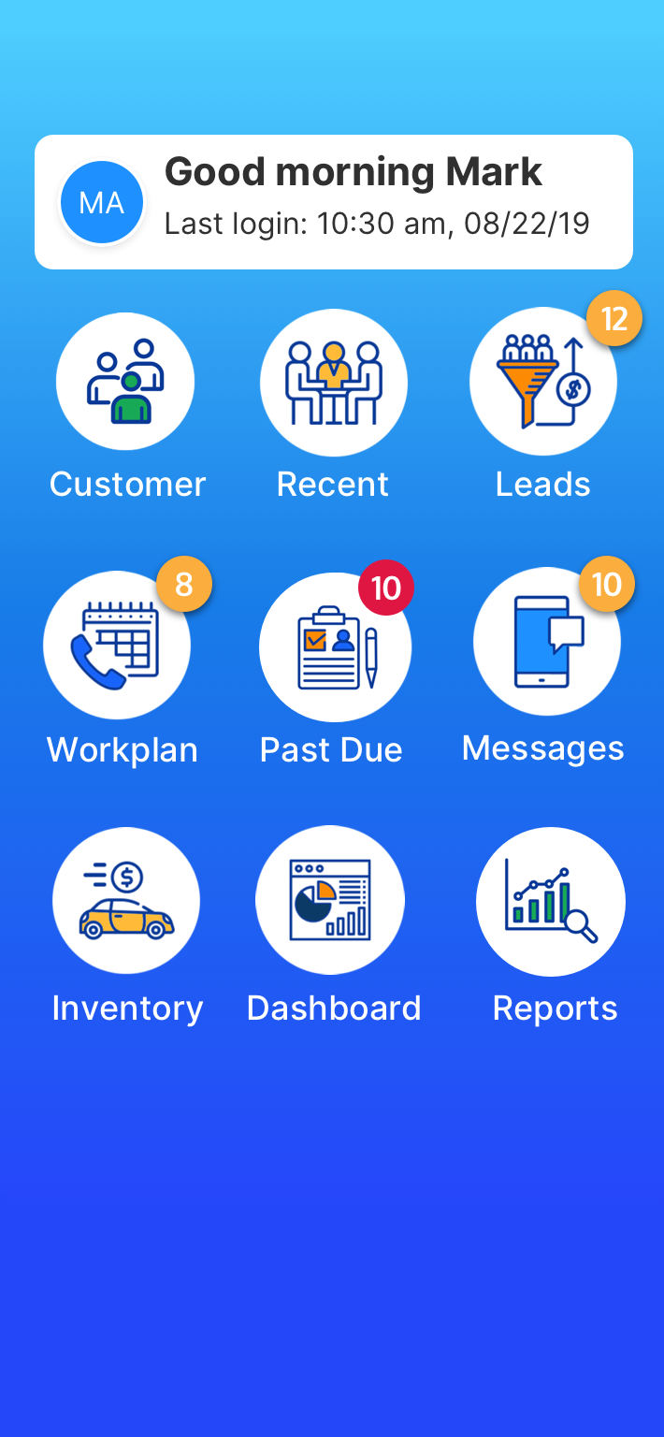
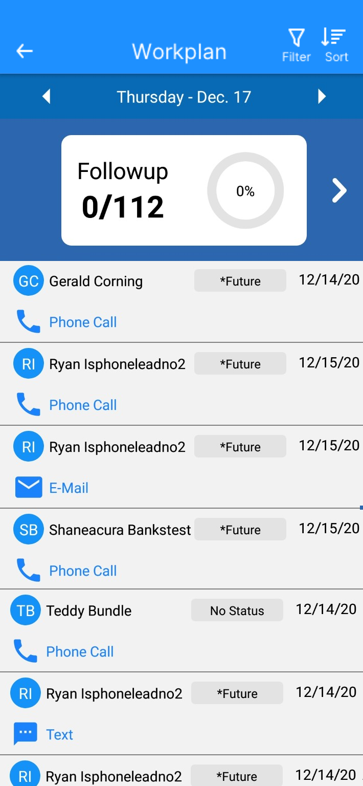
The ProMax App has everything a salesperson needs to do their job from any smartphone or tablet!
EZ Up and Driver’s License Scan - New & Improved interface! Log ups from anywhere
Message Center - see new leads and stop the clock immediately with New & Improved texting and email functionality
Workscreen - New & Improved interface! Access all the customer info you need
VIN Scan - New & Improved! scan the VIN from your device and view all Inventory
Workplan - manage all of your work from anywhere; complete tasks and make notes, it’s easier than ever
And much more!

Slide 13
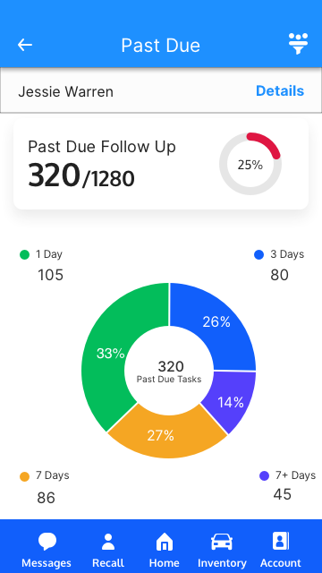
The ProMax App also features a robust set of manager tools!
Management Reports - Store Traffic Report, Appointment Log, SMS History Report, and more. Get the data you need no matter where you are
Past Due Follow-up- All New! View opportunities so nothing slips through the cracks; drill down to individual employees
Daily Workplan- see everyone’s workplan; track tasks while you’re out on the lot
Inventory - access the Unbooked Inventory Report and add or edit vehicles
Working Deals - check in on deals in progress and monitor gross, payment, and price
And much more!

Slide 14

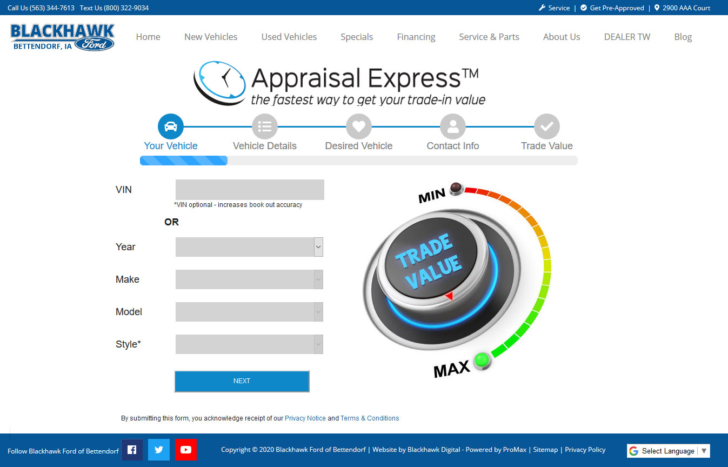
Give customers a better online buying experience with Appraisal Express Plus
More and more customers expect to complete the initial steps of the car buying process online. Appraisal Express Plus enables consumers to get a trade appraisal PLUS get instantly pre-approved and see their credit score. Your customers get what they’re looking for and you get a high-quality lead delivered to your CRM!
Now this proven online lead generator is even better, integrating with your website’s inventory so customers can use their AE+ projected credit score and equity to see realistic estimated payments before setting foot on the lot.

Slide 15
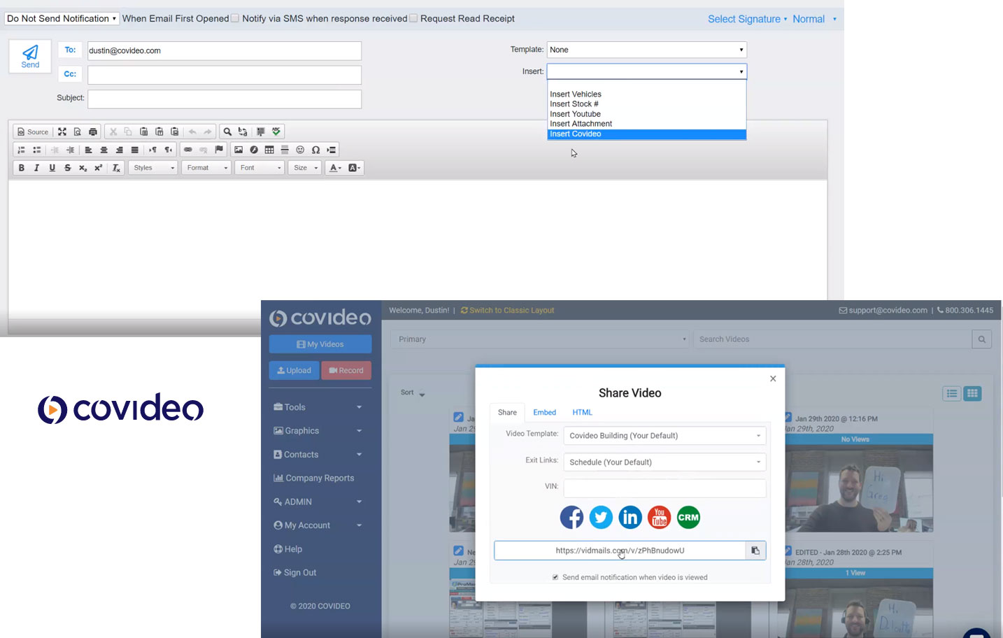
New Integrations
Z
Covideo
Integration
ProMax now integrates with Covideo, an easy-to-use video solution that displays a preview GIF in emails linking to full personalized videos in the browser.

Slide 16
ProMax Automotive Software Solutions
o
g
Leverage the industry’s top desking solution to simultaneously desk all available lease and retail options before selecting the best choices for your customer
Maximize your ability to find, attract, and sell new prospects, nurture and retain your current customers, and entice previous customers back in
CRM
Inventory
Easy to use, customizable, and scalable depending on your dealership needs
O
The ProMax Inventory module makes it easy for auto dealers to professionally and accurately manage, analyze, optimize, and market your inventory
C
Desking
ILM

Slide 17
Products to help you sell more cars
K
K
We offer a Compliance Solution that protects your dealership, but doesn’t disrupt the sales process or require hours of management
AI powered analytics that identifies & measures key metrics on both inbound & outbound calls, integrated directly into ProMax
Credit Bureaus
Soft Pull
.
S
Pulling credit and staying compliant is seamlessly woven into your sales process making it simple to review and manage
The automotive industry’s first pre-screen solution. Now available through TransUnion and Equifax
Compliance
Call Tracking

Slide 18
Digital Marketing Products
Improve the Car Buying Process for your customers
BDC
Increase appointments and showroom traffic with our experienced staff that knows the car industry
Instant App
Enable customers to instantly see if they are pre-approved and see their credit score
U
s
b
B
Websites
Custom built, SEO effective, fully responsive websites with complete ProMax integration
Appraisal Express
Let customer see their trade in value, payoff, and equity along with seeing if they are pre-approved

Slide 19
Trigger Leads
Target prospects that have had their credit report pulled for the purpose of auto financing whether by a dealer or a lender
c
Service BDC
v
I
Direct Mail
Drive traffic to your service and parts departments with professional campaigns and streamlined follow-up
Supercharge your lead generation efforts with ProMax’s award-winning Direct Mail solution
Lead
Generation
Target the right prospects
Convert more leads
Showroom BDC
v
R
Bankruptcy Leads
Increase appointments and showroom traffic with our experienced staff that knows the car industry
Use our extremely effective and automated system to convert all the bankruptcy sales opportunities in your market area
j
Finance Leads
Prospects that have gone online and filled out a credit application looking to purchase a vehicle

Slide 20
Improve Customer Relationships
Building strong relationships leads to more sales
Sales
A CRM needs to be easy for your sales team to use and work into your sales process
Get More Leads
e
Digital Retailing has never been more important to your dealership. Make sure your systems work seamlessly so that no one slips through the cracks.
Consumers are expecting a smooth online buying experience. Be transparent and respond to leads as soon as you can.
Manage them effectively
Drive Customer Retention
Management
Accurate reporting helps you make decisions to increase sales and profits
d

Slide 21
Seamless integration of our products provide a great customer experience
Scaled to fit your dealership needs
d
Follow-up
Automated by event or status
ILM
Manage all of your leads in one system. Features to suit your dealership & OEM
Lead Gen
High quality leads based on your targeted demographics
M
CRM
Easy to use tool to manage your daily activities

Slide 22

Auto Dealer Monthly Dealer Choice Awards
Auto Dealer Monthly Dealer Choice Awards
2009
2010
2011
Diamond Desking
Platinum Desking
Diamond Desking
2012
2013
2014
Diamond Desking
Platinum CRM
Diamond Desking
Platinum CRM
Diamond Desking Diamond Direct Mail
Gold CRM

Slide 23
Auto Dealer Monthly Dealer Choice Awards
Auto Dealer Monthly Dealer Choice Awards
2015
2016
2017
Diamond Desking
Diamond Direct Mail
Platinum CRM
Diamond Desking
Diamond CRM
Diamond Direct Mail
Diamond Desking
Diamond CRM
Diamond Direct Mail
2018
2019
2020
Diamond Desking
Diamond Direct Mail
Platinum CRM
Gold Award CRM
Gold Award Direct Mail
Diamond CRM
Diamond Direct Mail

Slide 24
WHYPROMAX
Hear it from our customers
Inspiring testimonials
#whyProMax

Slide 25

I have used them as a salesman and sales manager for the last 13 or so years and it is by far the BEST CRM out. We switched to Vin Solutions for a short time and realized why ProMax is the best! Customer for life!
Matt Molton, Sales Manager
Mansfield Buick GMC-

Slide 26

I've been using ProMax as my CRM for the last four years. Great technology and the customer service exceeds my expectations every time.
Mike Komander, GM
Carite -

Slide 27

Everything is in one place. You can do everything so easily and see everything so easily! I have used 4 different CRM's and this is by far the best and easiest
Marisa Centano, BDC Manager
Ford Groves -

Slide 28

Their culture is to solve the issue right away, train now , not later. Try that with one of the corporate giants that charge 3-4 times as much.
ProMax has Midwest manners and work ethic, I’m in for the long haul."
John Caudell, DP
Preowned Motor Cars-

Slide 29

We think ProMax is great for a number of reasons. Always had great service. We have your website, desking tool and CRM. Desking tool works great makes figuring a lease so easy.
Rick Shields, GM
Shields Auto Center -

Slide 30

I want you and the entire ProMax Team to know what a great help you have been in growing our business and pointing out practices that we were not aware of or lax in using. The entire staff has been very helpful, forthright and knowledgeable to all of our team. The tools that ProMax provide are now a more valuable asset than ever before.
Patrick Allen, Sales Manager
- Warner Kia -

Slide 31
ProMax- Total Solution
We offer a suite of seamlessly integrated products to help dealers sell more vehicles - for more profit.
Drive
Operational Efficiency
We offer in-market data to target and convert active automobile shoppers and marketing dashboards to measure results.
E
Optimize
employee performance
Increase speed, team performance, & return on investment to deliver enhanced customer experiences.
Digital
Retailing
Customer
Experience

Slide 32

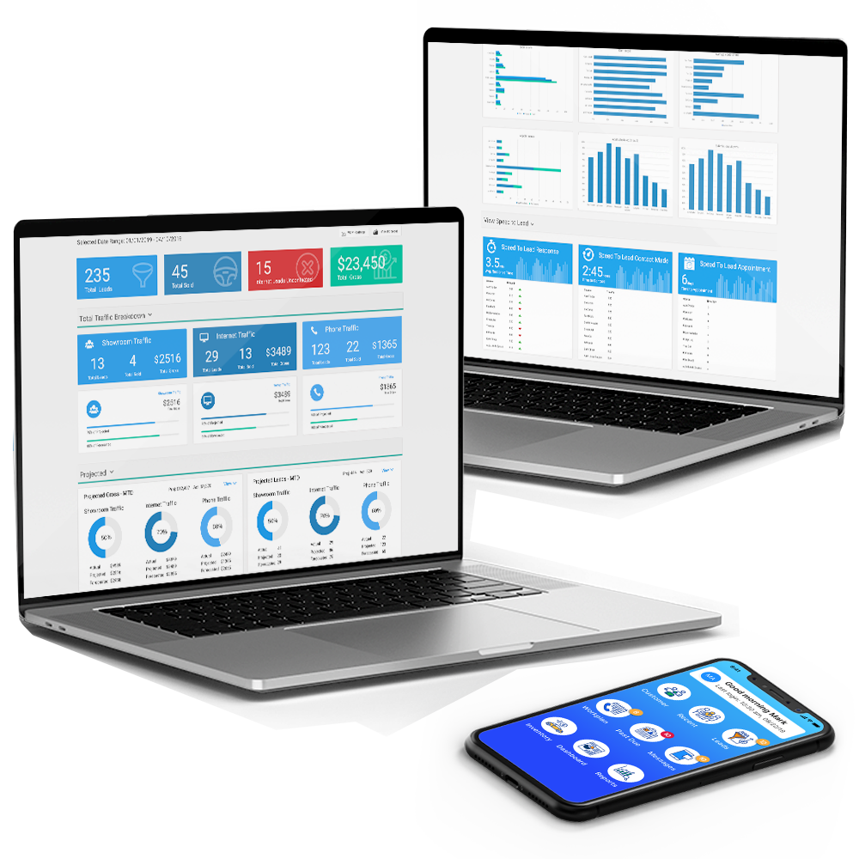
CRM
INVENTORY
LEAD GENERATION
CALL TRACKING
WEBSITES
REPORTS
DESKING
COMPLIANCE
ILM
MOBILE

Slide 33

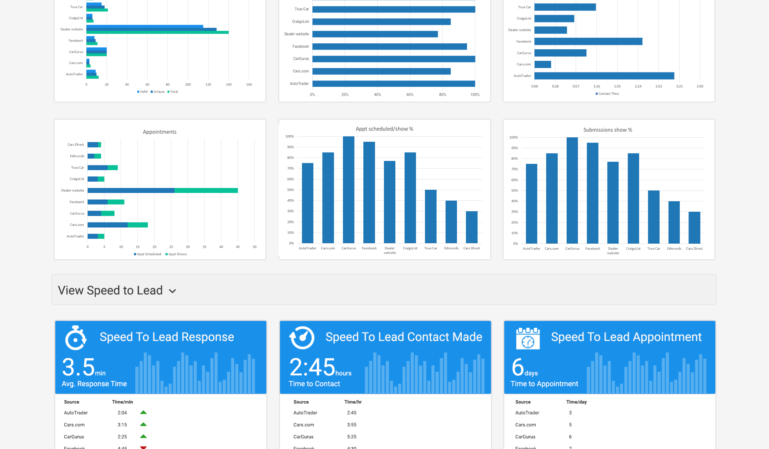
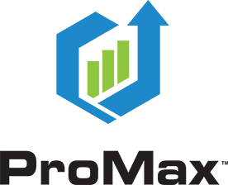
Get special FCA pricing and start building better relationships!
Fast, Flexible and easy-to-use
Sell more vehicles, more profitably, while improving your customers’ buying experience.
Contact Us Today!
800-322-9034
www.promaxunlimited.com
sales@promaxunlimited.com

Slide 34

THE COMPLETE SOLUTION
COMPLETE FRONT END SOFTWARE FOR YOUR DEALERSHIP

