Slide 2
NADA 2021
Blackhawk Digital
Digital Retailing, Website Design and Development
Internet Marketing
and Lead Generation

Slide 3
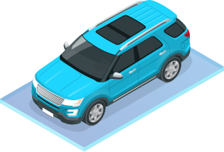
Digital Retailing Solutions
Navigating your customers through your digital storefront.
Custom designed websites
Secure credit applications
Instant Auto Pre-approval
Trade Appraisal with instant credit pre-approval
Inbound and Outbound Call Tracking
Trigger Leads
Internet Leads
BK Leads
Direct Mail
BDC Services

Slide 4
The
Buyers
Journey

Slide 5
Research Online
95%
95% of automotive shoppers start the research phase online, primarily starting with 3rd party websites.
Days in Market
65%
65% of them will purchase in less than 3 weeks
Buyers Shopping Experience
52%
52% of car shoppers feel anxious or uncomfortable at dealerships
Dealership Visits
41%
41% of car buyers only visit one dealership

Slide 6
Create a seamless journey
Customer Experience is overtaking price and product as the key brand differentiator

Slide 7
D
Websites
Custom, Mobile First Design with an Easy-To-Use Online Management tool
Identifying and targeting vehicle shoppers when they are most likely to purchase
n
Credit Solutions
Turn website visitors into leads by leveraging soft pull credit technology
W
Digital Retail Plug-ins
Can be placed anywhere on a dealership’s website

Slide 8
Responsive websites proven to convert more visitors into highly qualified leads

Slide 9
D
n
g
b
Mobile First
Integrations
SEO
Analytics
Provide your customers with a streamlined experience no matter how they are visiting your website
We are partners in your success. We integrate with any CRM or directly with ProMax CRM/ILM
We optimize your content specifically for your business and stay up-to-date with all changes from Google, Yahoo, Bing and more!
Our built-in analytics tool takes information from Google Analytics and provides it in a easy to understand format accessible right in your online management system.

Slide 10
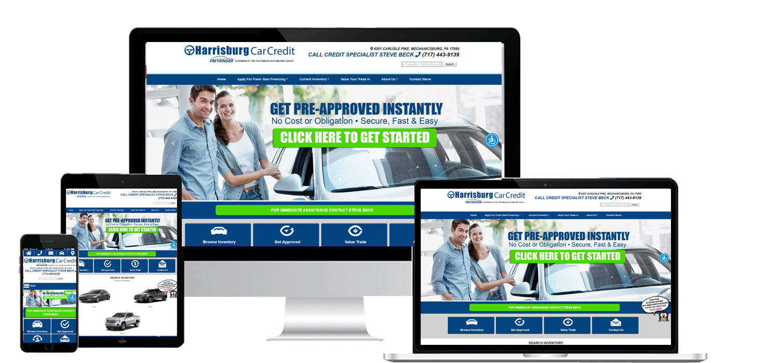
Engage customers and automate communications
Shorten the length of your car sales cycle and build customer loyalty at the same time

Slide 11
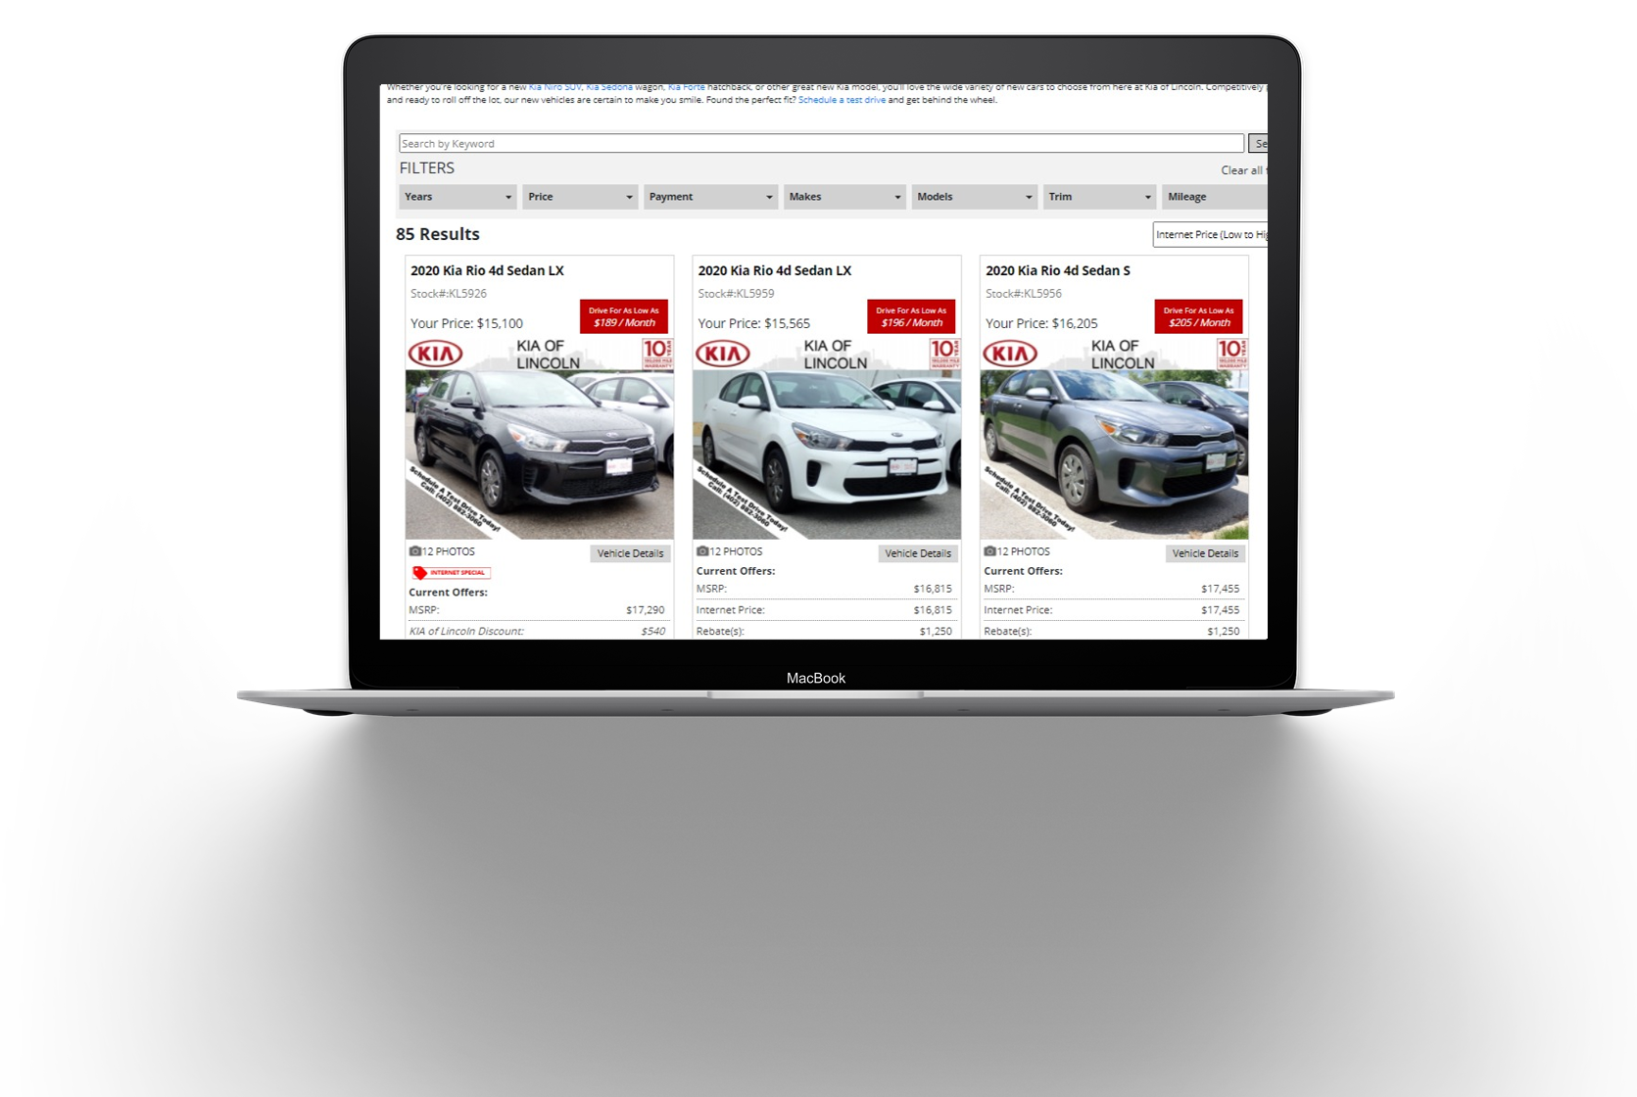
Dynamic Search Results and Vehicle Detail Page
Provide customers a better buying experience.
Help your customers navigate your website quickly and give them the information they want. Have happier, more educated customers.

Slide 12
We have had Blackhawk Digital host and maintain our KIA Dealer Website since 2013. In March of 2016 we redesigned our website to remain ahead of the pack, we now have a modern looking fully responsive website that rivals any website the “Big Box” companies could provide. They also make sure I stay compliant with KIA for all my graphics and specials. Previously we have used Dealer.com, we now pay half the cost of what we were paying them. I have increased my monthly website traffic from 2000 visitors to an average of 3800 per month now! The dynamic SEO platform they use will help any dealer in any size of market achieve success.
Kyle Hager, GSM
Kia of Lincoln-

Slide 13
Instant App
Break away from standard website forms and give your customers valuable information they can use to enhance and speed up their car buying process.

Slide 14
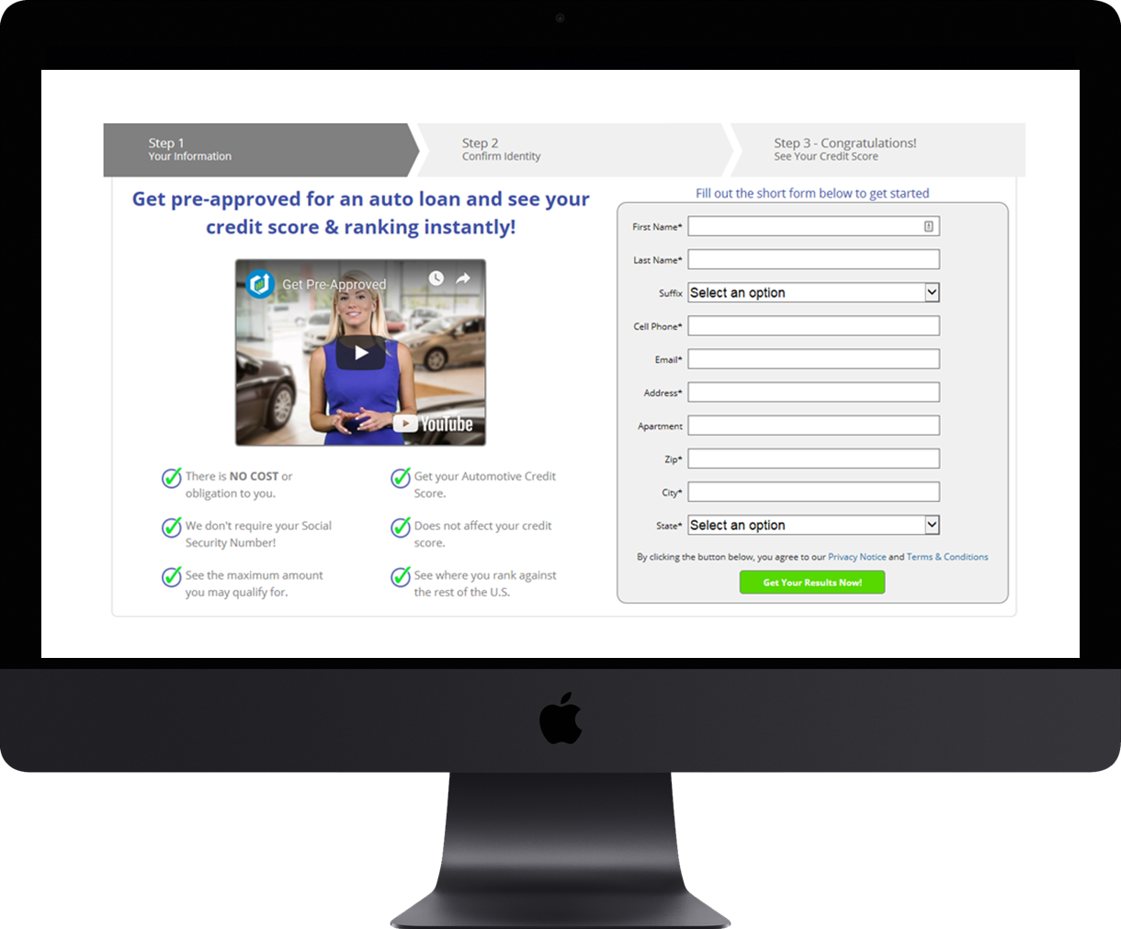
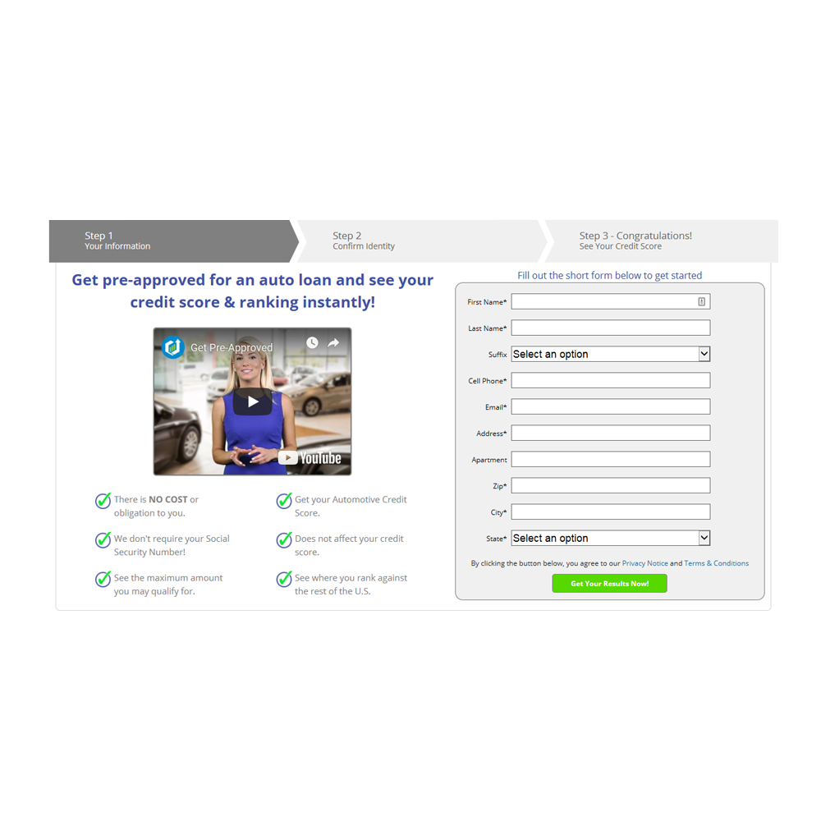
Pre-qualify your customers in seconds
Get customers further along in the buying process
Enables website visitors to instantly get pre-approved and see their exact credit score. It is quick and easy and doesn’t require the customer to provide their Social Security Number.
Increase Your Leads &
Learn More About Your Visitors
Break away from standard website forms and give your customers valuable information they can use to enhance and speed up their car buying process.
Valuable & Unique Information
Receive your customer’s exact credit score, vehicle payment, interest rate, original loan amount, est. payoff, term of loan, if joint application, and number of times late in the last 24 months.

Slide 15
We really like our Blackhawk Instant App. We have been using it since February of 2014. I feel we get a much higher quality lead than other 3rd party leads we have tried. One of the best things about the Blackhawk Instant App is that the customer does all the work for you! We have it advertised all over our websites and have found that customers are very comfortable submitting their information without having to give a social security number. It is turning our website traffic into leads!
Alisa Rocha , Internet Manager
- Carmack Car Capitol -

Slide 16
Appraisal Express Plus
Backed by JD Power, this digital sales tool makes buying a car faster, easier, and more beneficial for everybody.
Your buyer will:
Instantly get pre-approved
Receive trade value, equity and payoff
Learn their credit score and max loan amount

Slide 17
Appraisal Express Plus
With every Appraisal Express Plus lead you will be able to get valuable information
Payoff
Finance Options
Vehicle data
Equity
Payment
Trade
Get Payoff and Equity information from TransUnion
Serve your customers a Payment based off of their Equity and pre-approval status
Get trade info, FICO, Equity, Payoff, AutoSummary info, Desired Vehicle
X
n
B

Slide 18
We were previously using the KBB Instant Cash offer program and weren’t getting as great of return as promised so we decided to switch to the ProMax NADA powered variant called “Appraisal Express” It is super simple to use and we are seeing 25-40 leads come in every month. We typically see 10-20% of those leads turn into appointments/buyers! The cost Is minimal and well worth the investment.
Joseph Hawk, GM
- Kama'aina Nissan-

Slide 19
Fill your pipeline with quality sales leads
Outbound marketing channels to generate highly-targeted traffic
B
D
f
E
T
Trigger Leads
Maximize your marketing dollars by targeting consumers that are actively pursuing an auto loan and have the intention of buying a car today
Internet Leads
Save time and effort with our guaranteed solution that delivers high quality prospects who have filled out an online credit application
Bankruptcy Leads
Use our extremely effective and automated system to convert all the bankruptcy sales opportunities in your market area
Direct Mail
Supercharge your lead generation efforts with ProMax’s award winning Direct Mail solution
BDC Services
Our experienced BDC in conjunction with our award-winning mail solution and lead generation tools will supercharge your appointments
Attract your Ideal Buyer
Cost effective lead generation tools to fill your pipeline and put your brand in front of consumers at the moment they are looking for a vehicle

Slide 20
BDC Services - Providing a better customer experience
We help dealers maximize their potential by turning mishandled opportunities into positive customer experiences.
Packages Available
After-Hours
SERVICE CAMPAIGNS
SALES CAMPAIGNS
Development
Our experienced BDC in conjunction with our award-winning digital solutions and lead generation tools will supercharge your appointments and ensure that no leads slip through the cracks.
A valuable extension of the dealer’s service lane. Let the experienced, professionally trained BDC Team at ProMax drive more traffic to the service and parts departments through carefully crafted campaigns and streamlined follow up. Reasonably priced service with a partner motivated to expand their customer loyalty and increase profitability of the store.
ProMax BDC After-Hours Response System will send a professionally designed email template to a consumer who inquires when the dealership is closed. The email is sent within minutes of the lead coming into the system and will stop the response clock for the OEM.
Whether you need a full engagement program or specific campaign follow up, we can handle your BDC needs. We provide cost effective solutions that can be scaled to meet most any budget a dealer has. No set up fees and no monthly minimums.

Slide 21
Blackhawk-Digital
Partners in Your Success
Our team will evaluate your dealership’s needs and formulate a plan on how to achieve your desired goals.
Contact us:
800-322-9034
www.Blackhawk-Digtial.com

